Slide 1
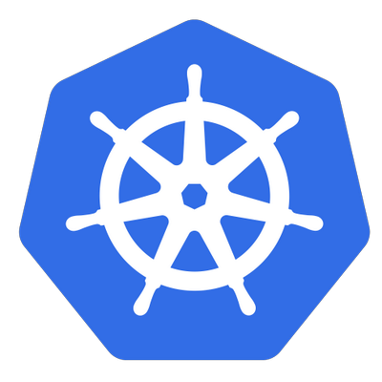
Kubernetes

Slide 2
Container Technology

Slide 3
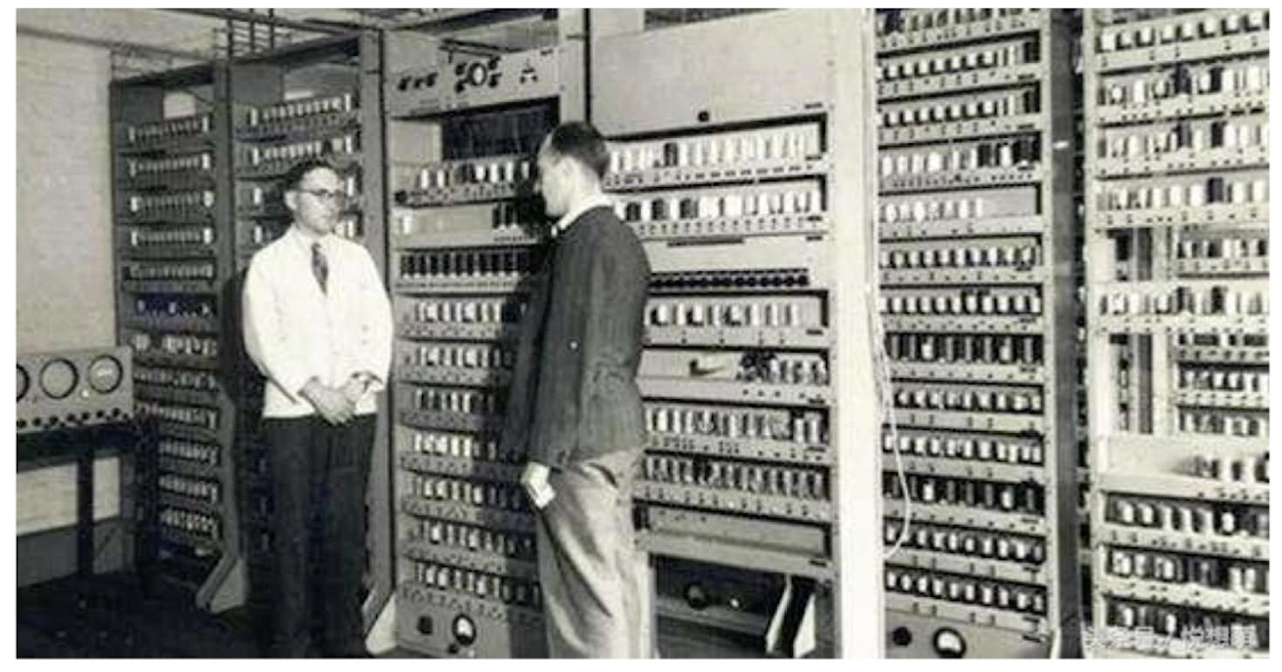
A bit of History

Slide 4
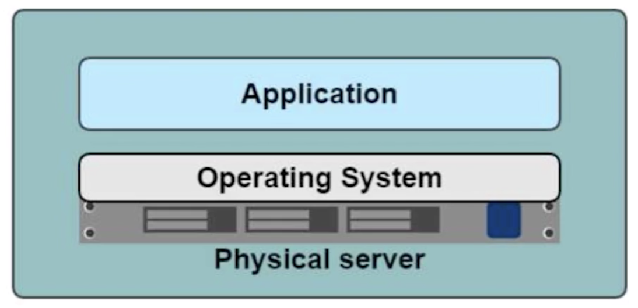
Long Long Time Ago
Deployment - Slow
Cost - High
Migration - Hard

Slide 5
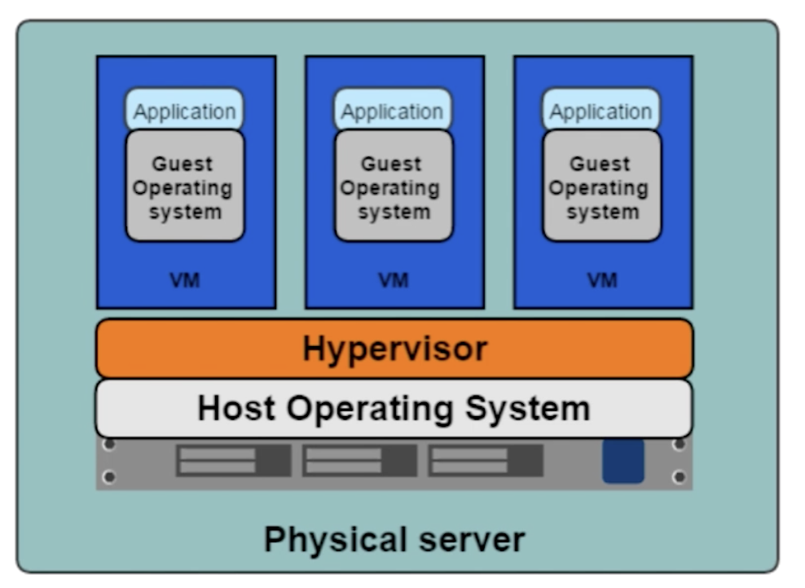
Virtualization
Deploy many apps in one physical machine
Each app run in a single VM

Slide 6
The Advantage of Virtualization
Resource Pool : like CPU, Memory
Easy to do extension : add more VMs or physical machine
Cloud : like AWS, Azure

Slide 7
The Limitation of Virtualization
Every VM has its own operating system, when the amount of VM increase, the cost of them can’t be ignored.
Waste of resources

Slide 8

Why Container?

Slide 9

Why Container?

Slide 10
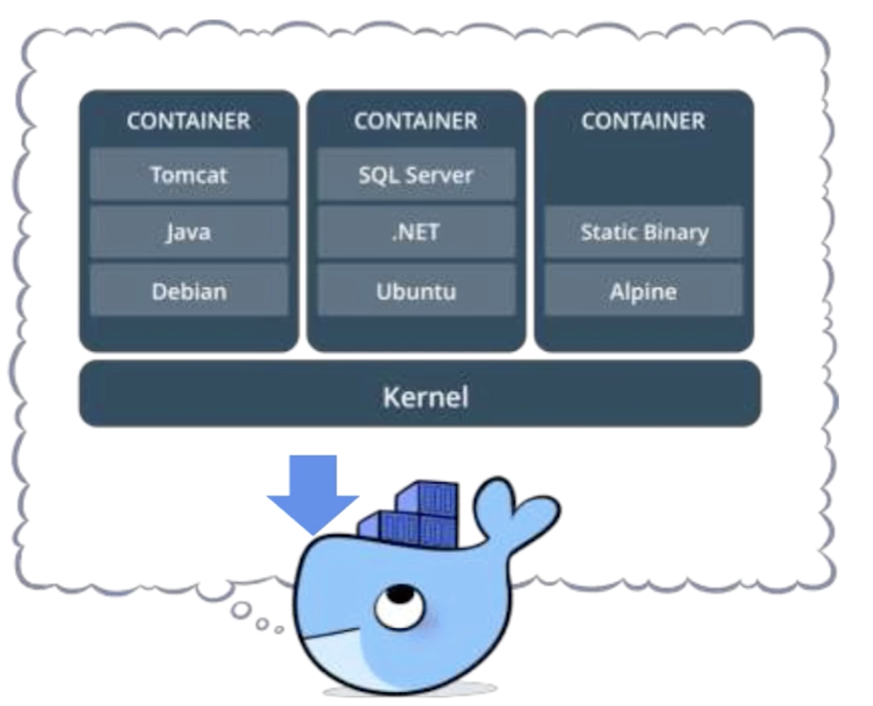
What is Container
Package of software and requirements
Isolation of applications
Share the same of kernel
Can run on the top of many kinds of OS

Slide 11
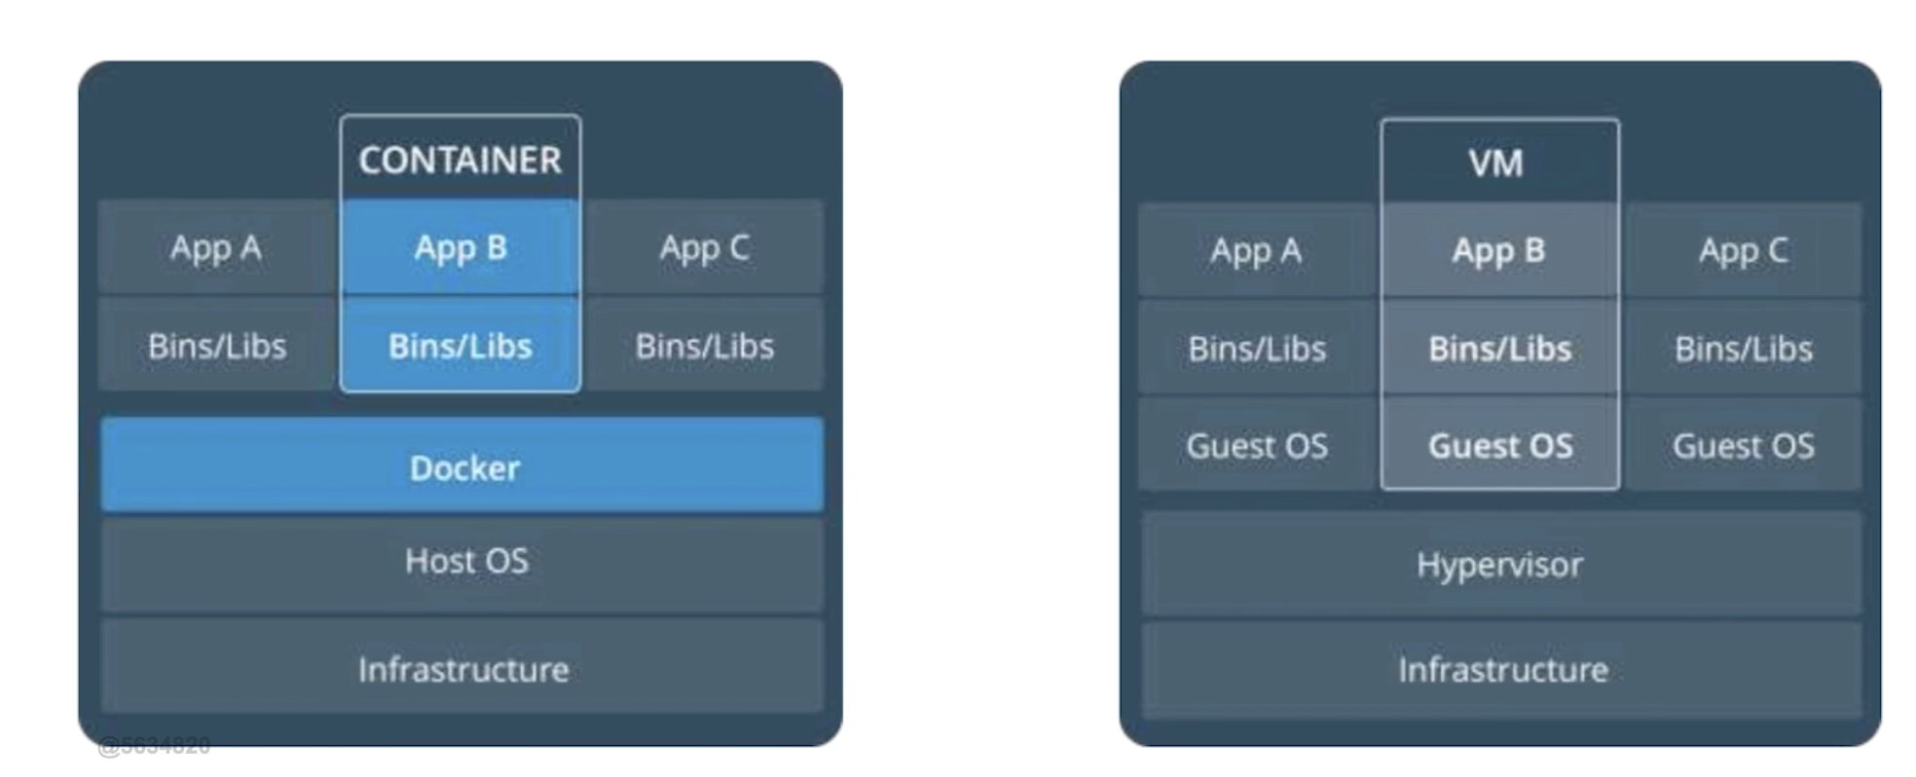
Difference between Container and VM
Container: Isolation of application
Virtual Machine: Isolation of physical resources.

Slide 12
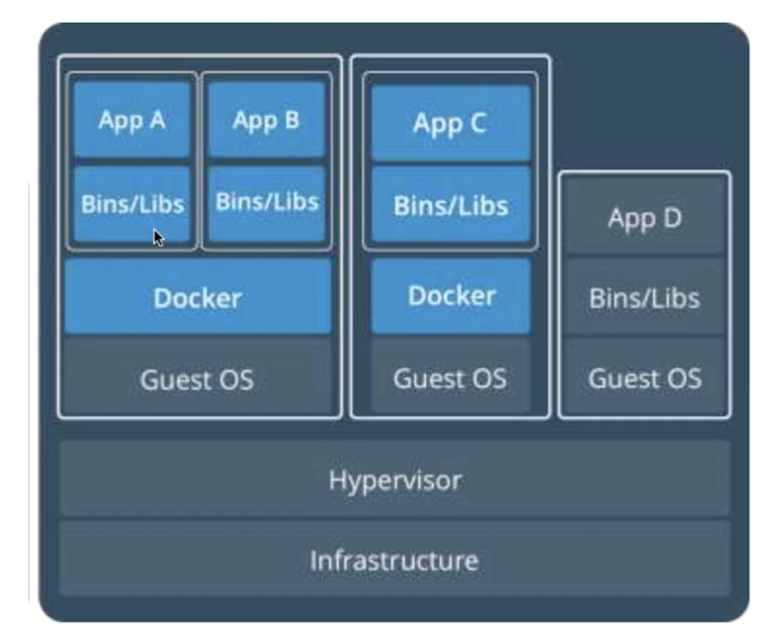
Container + VM

Slide 13
Container Orchestration

Slide 14
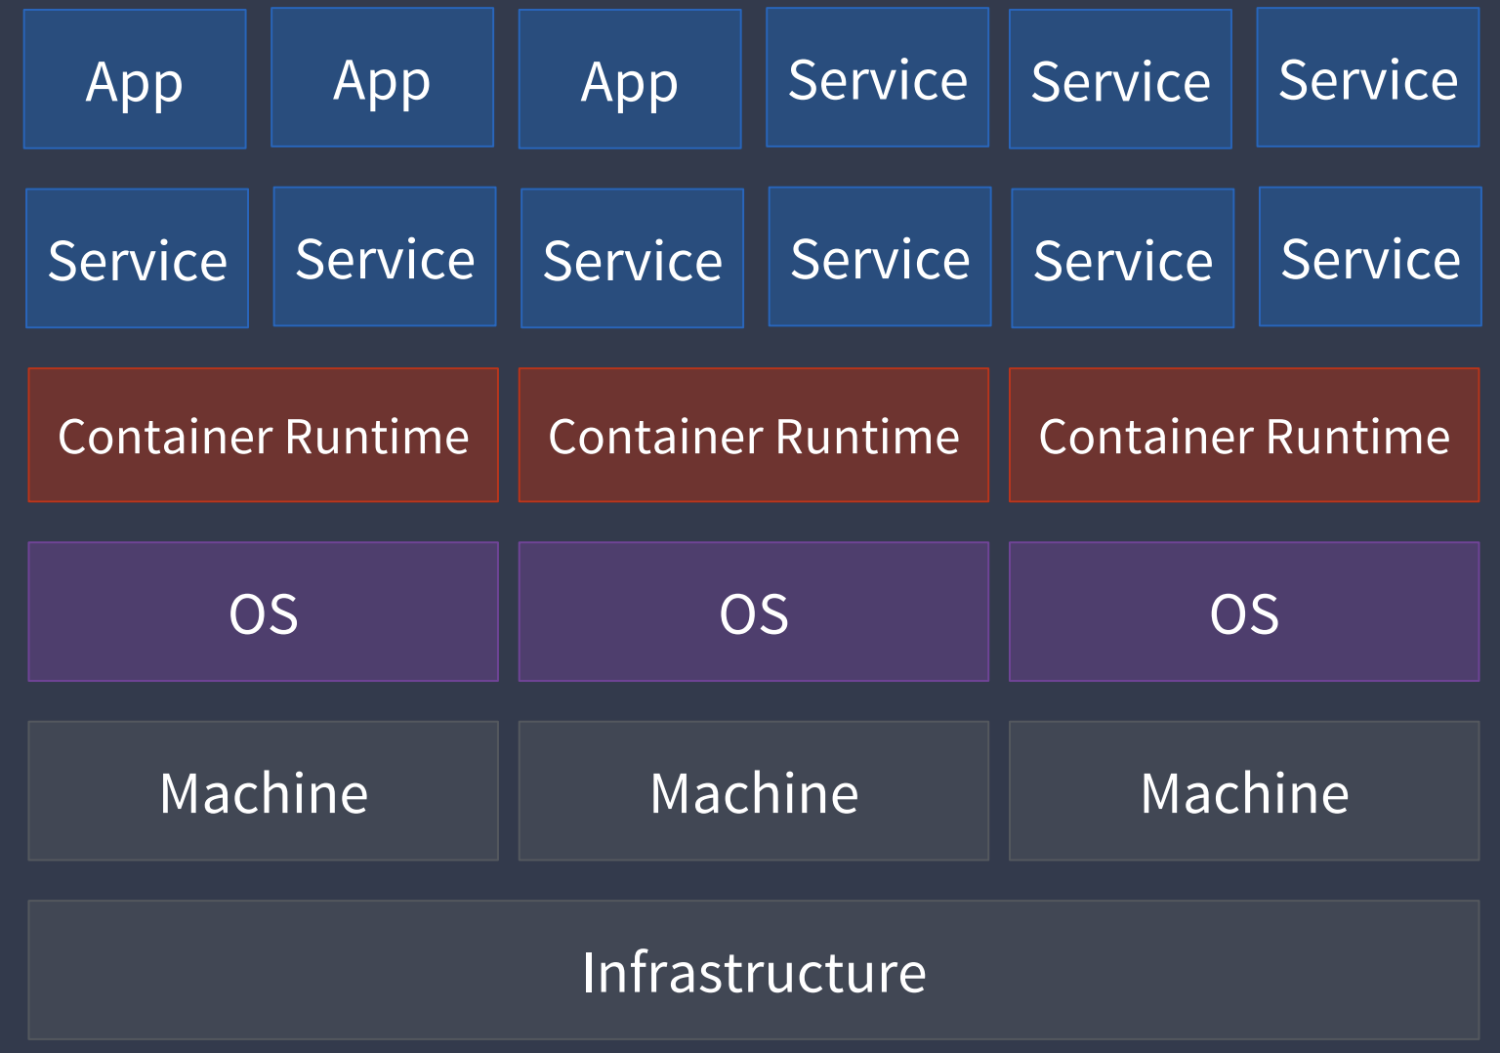
What is Container Orchestration

Slide 15
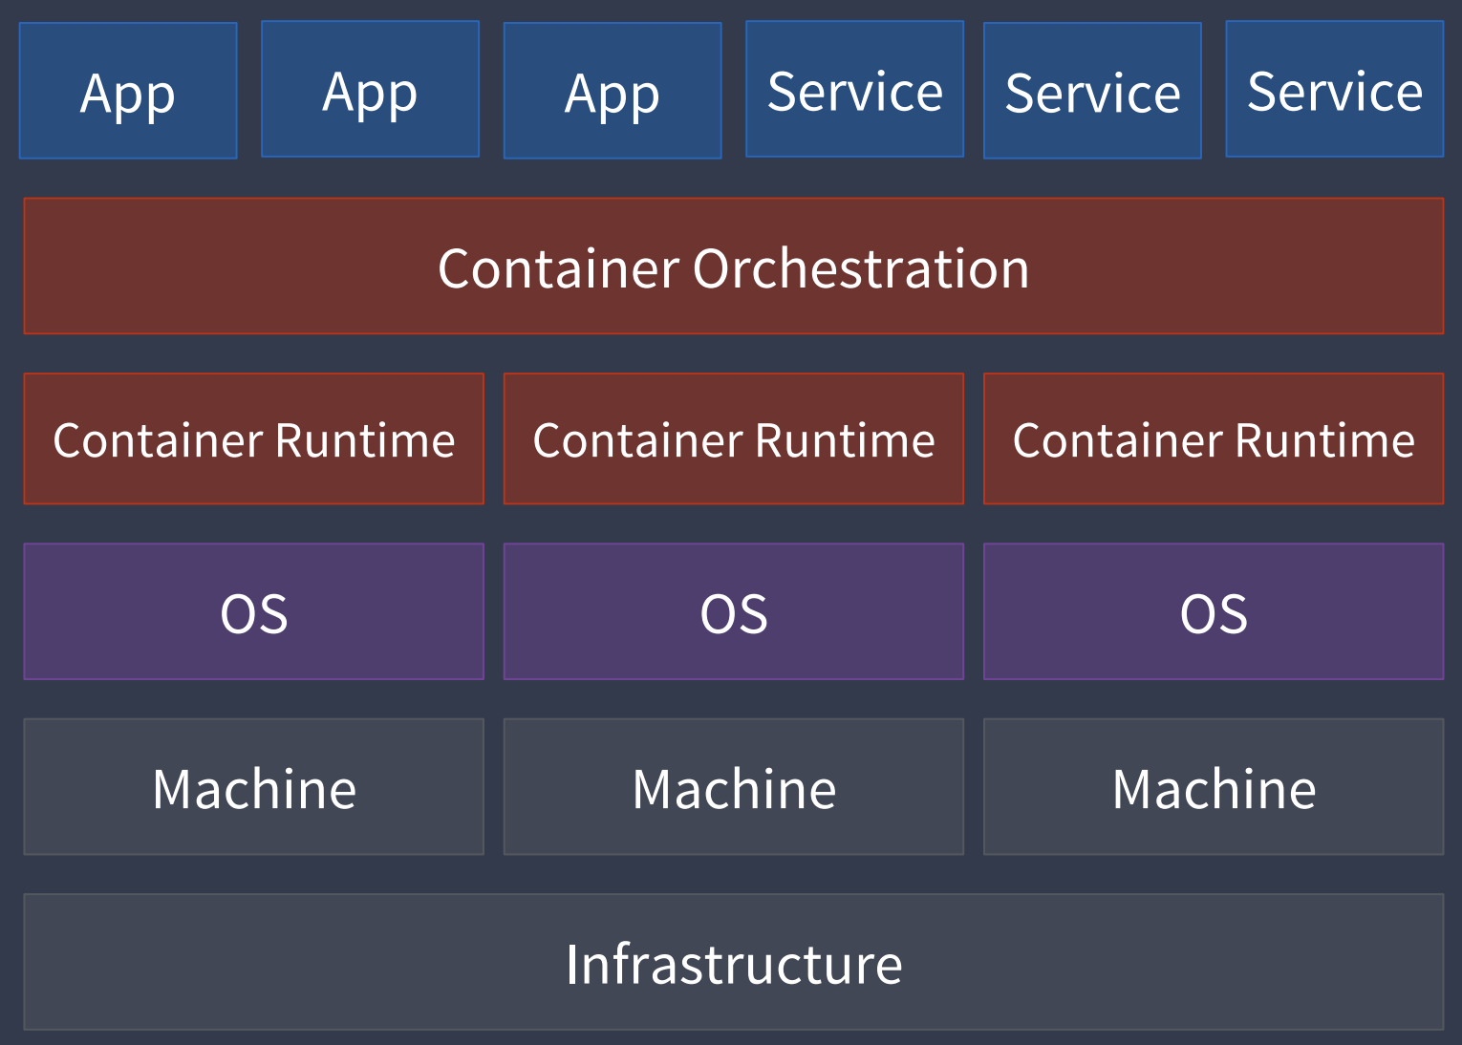
What is Container Orchestration

Slide 16
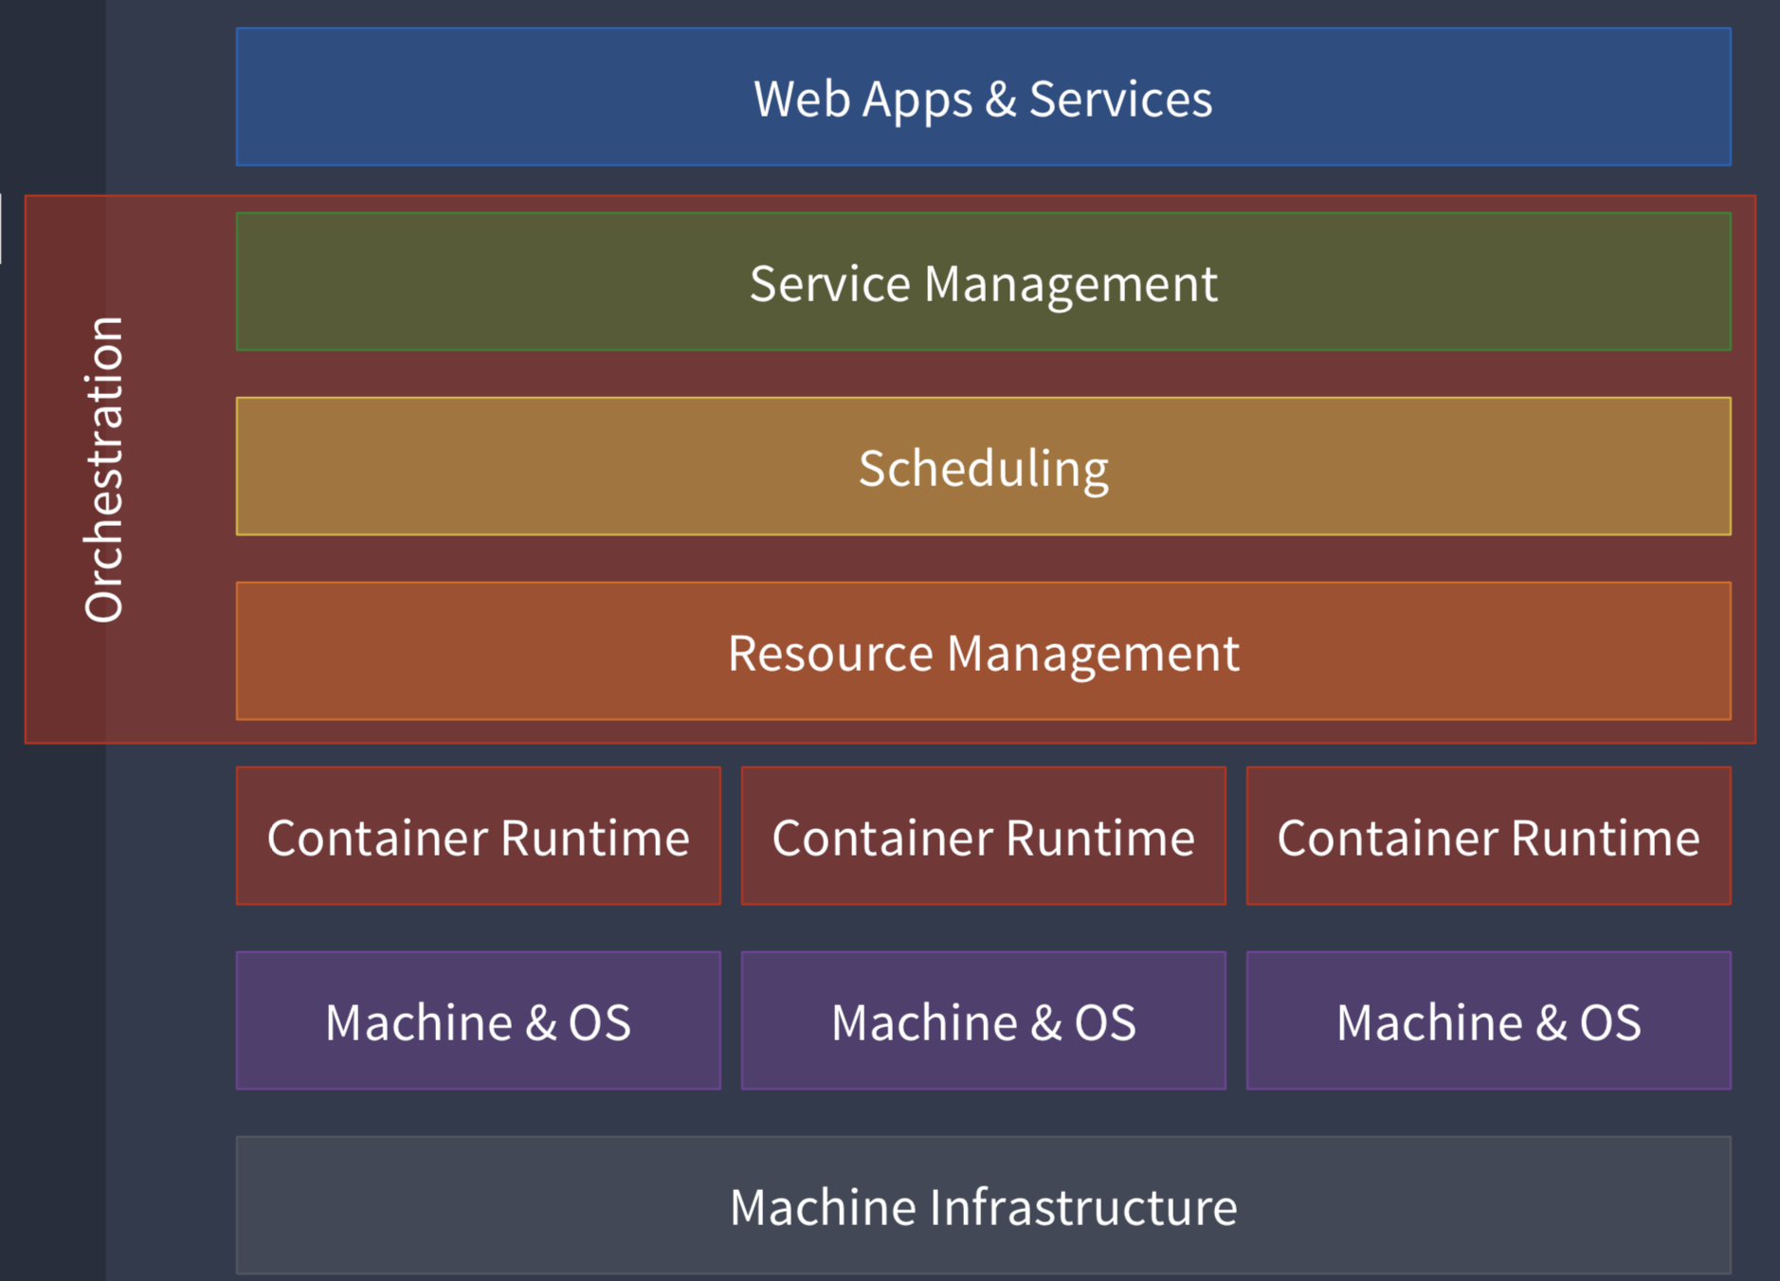
Orchestration Layer

Slide 17
Solutions
Docker Swarm
Kubernetes

Slide 18
Kubernetes Introduction

Slide 19
What is Kubernetes
Born from a Google internal Project in mid 2014 (Borg)
Released 1.0 in July 2015
v1.12

Slide 20
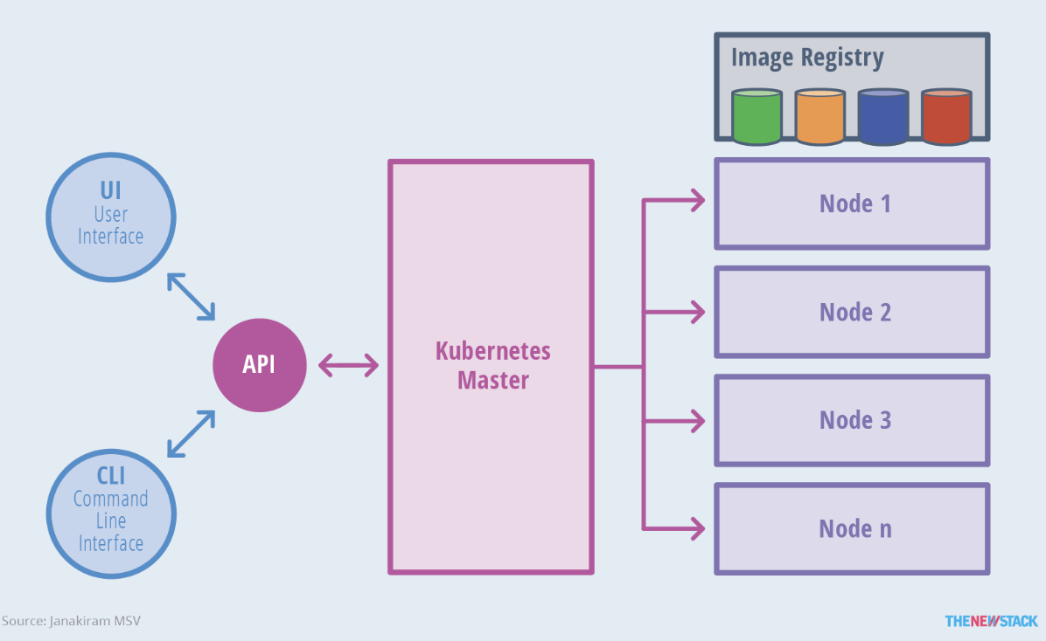
Kubernetes Architecture
kubectl

Slide 21
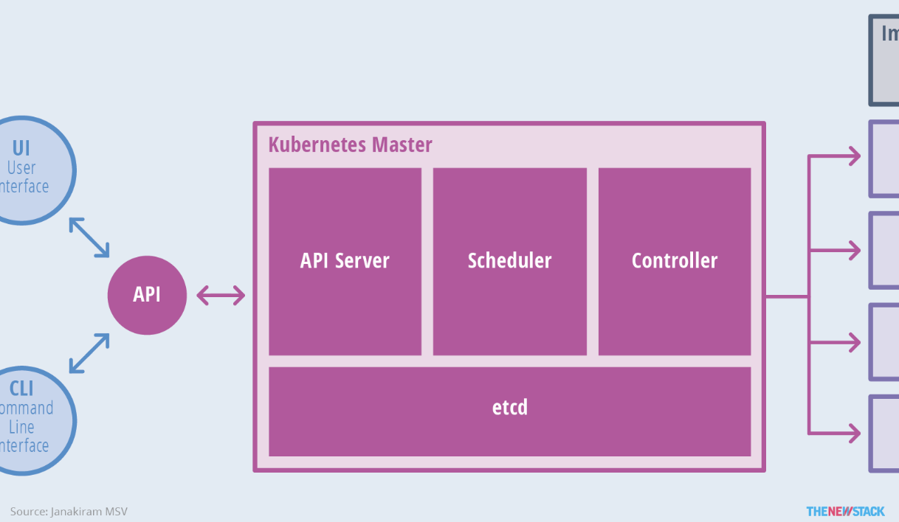
Master Node

Slide 22
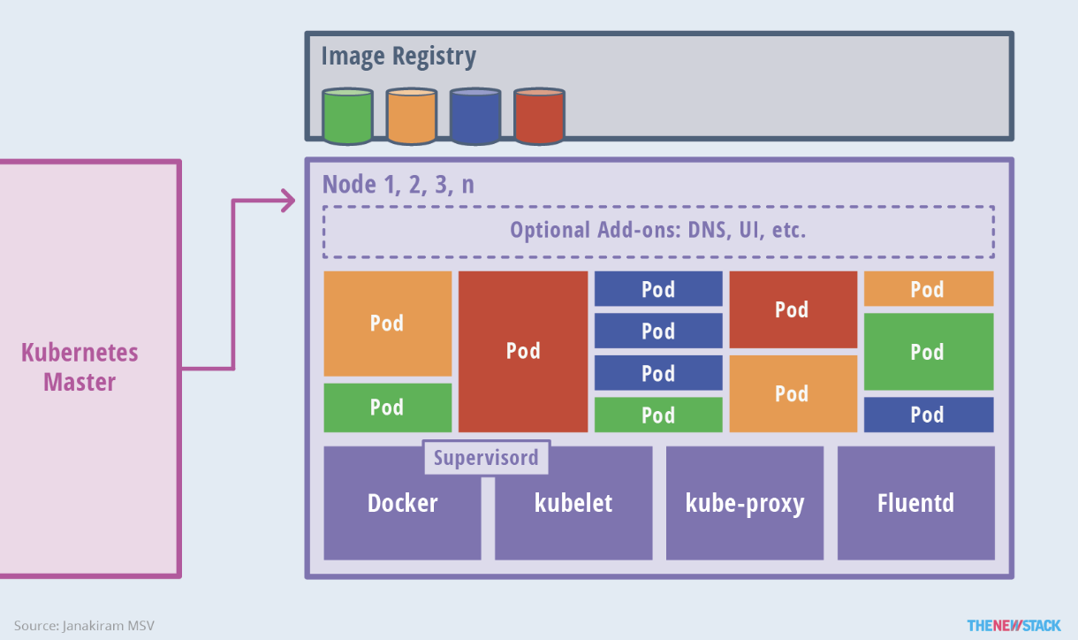
Worker Node

Slide 23
Pod

Slide 24
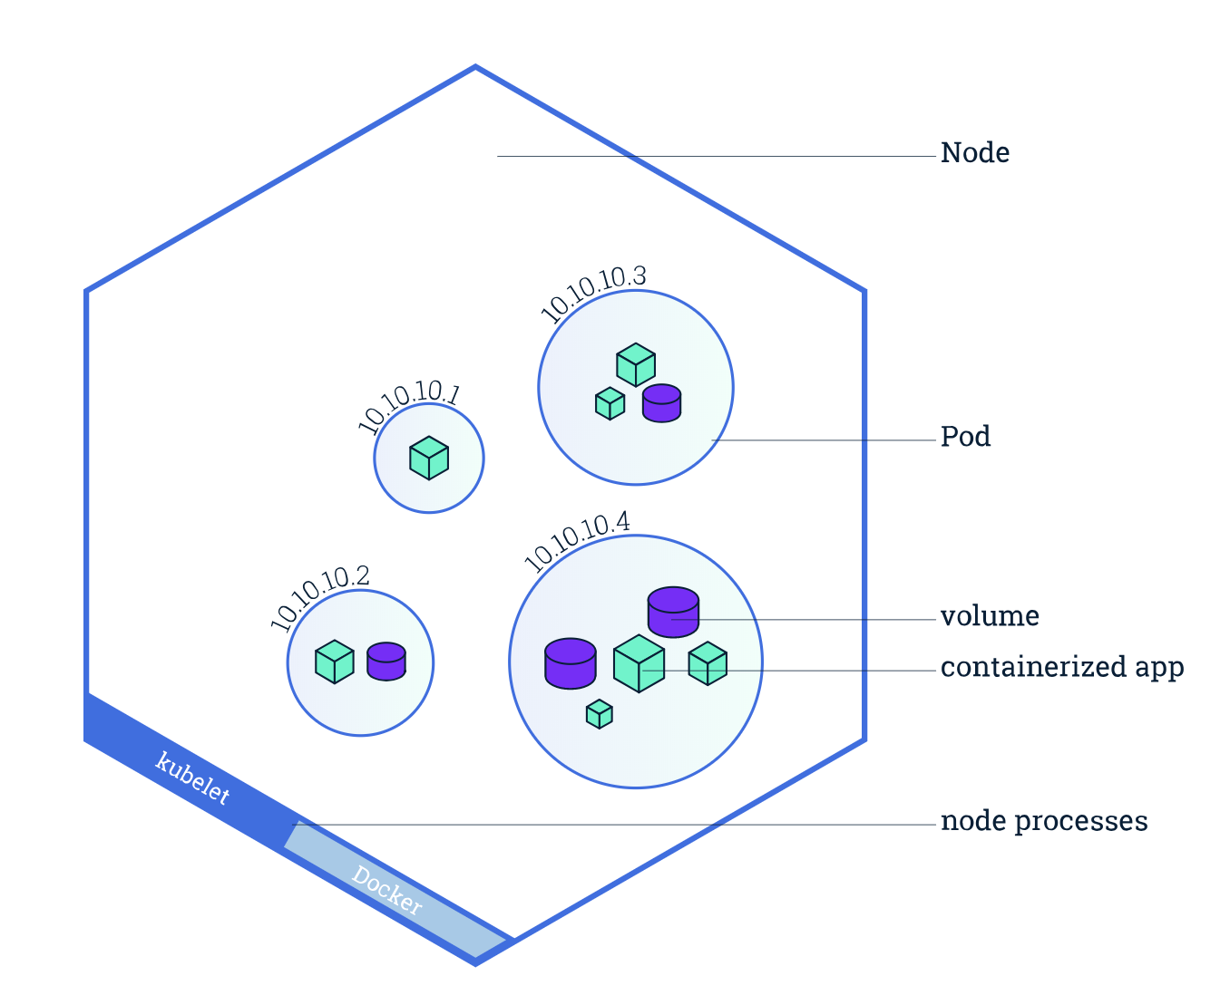
Pod Overview
A group of one or more application containers and their shared resources like volume.
A pod share the same name spaces like network name spaces (have same IP address.)
Pod is the smallest unit for K8s scheduling

Slide 25
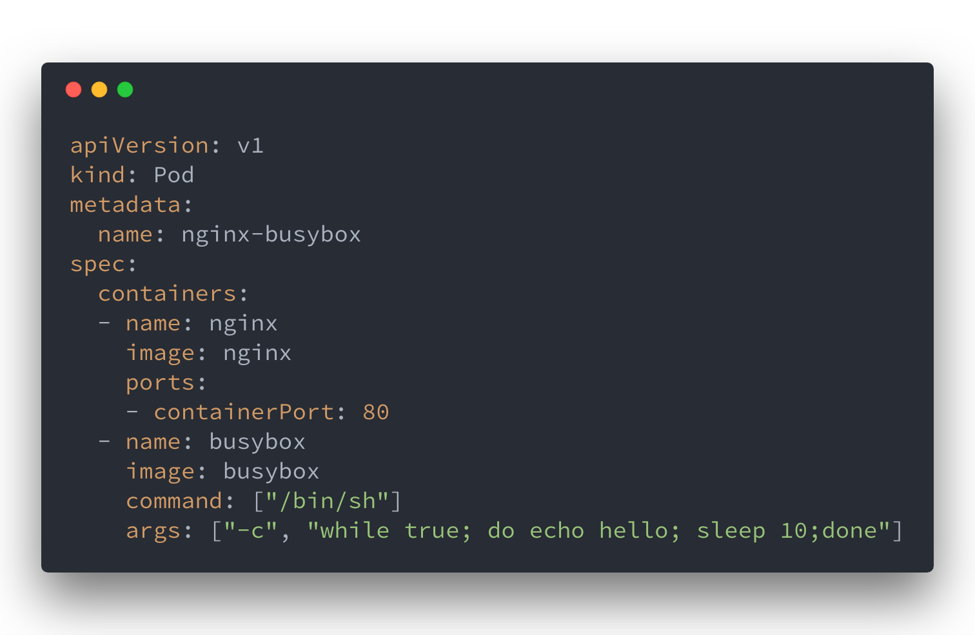
Pod Definition

Slide 26
Create Pod
$ kubectl create -f nginx_busybox.yml pod "nginx-busybox" created

Slide 27
Pod Operation
$ kubectl get pods NAME READY STATUS RESTARTS AGE nginx-busybox 2/2 Running 0 57s
$ kubectl describe pod nginx-busybox
$ kubectl get pods nginx-busybox -o wide NAME READY STATUS RESTARTS AGE IP NODE nginx-busybox 2/2 Running 0 3m 172.17.0.4 minikube
$ kubectl exec nginx-busybox -it sh Defaulting container name to nginx. Use 'kubectl describe pod/nginx-busybox -n default' to see all of the containers in this pod. # # $ kubectl delete -f nginx_busybox.yml pod "nginx-busybox" deleted

Slide 28
Namespace

Slide 29
Namespaces
Namespaces are intended for use in environments with many users spread across multiple teams, or projects. For clusters with a few to tens of users, you should not need to create or think about namespaces at all. Start using namespaces when you need the features they provide.
Namespaces provide a scope for names. Names of resources need to be unique within a namespace, but not across namespaces.

Slide 30
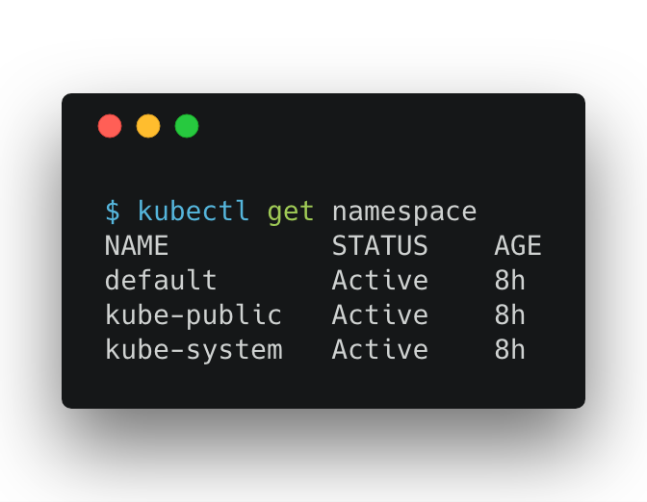
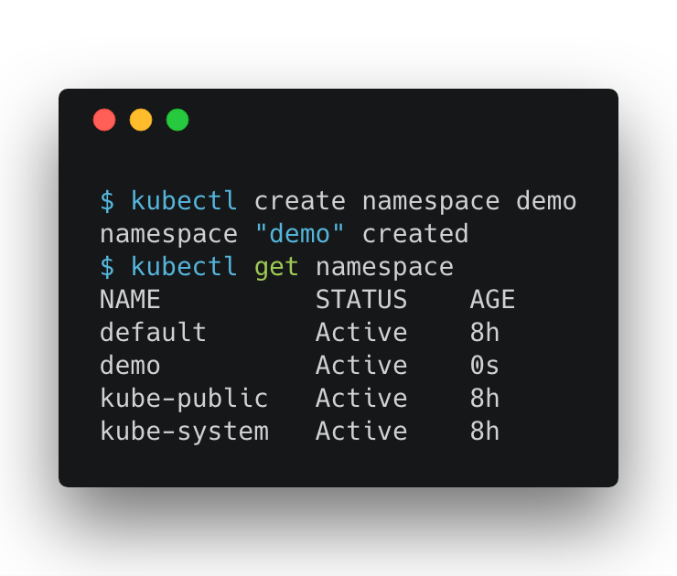
Get and Create Namespaces
Notes:
default The default namespace for objects with no other namespace
kube-system The namespace for objects created by the Kubernetes system
kube-public The namespace is created automatically and readable by all users (including those not authenticated). This namespace is mostly reserved for cluster usage, in case that some resources should be visible and readable publicly throughout the whole cluster. The public aspect of this namespace is only a convention, not a requirement.

Slide 31
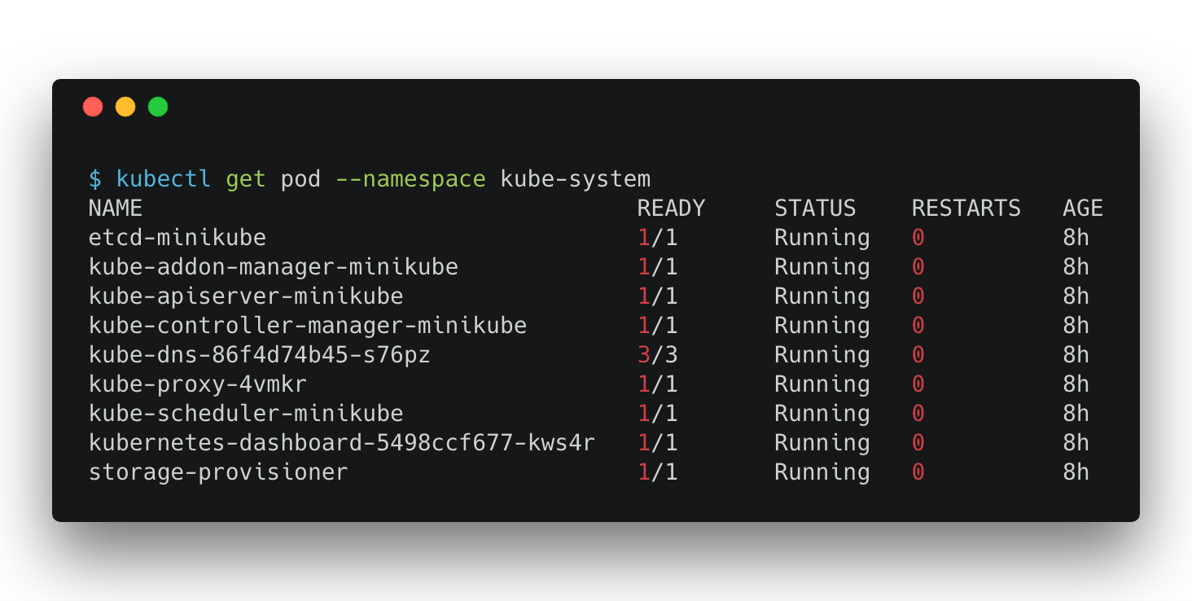
Filter pod with namespace

Slide 32
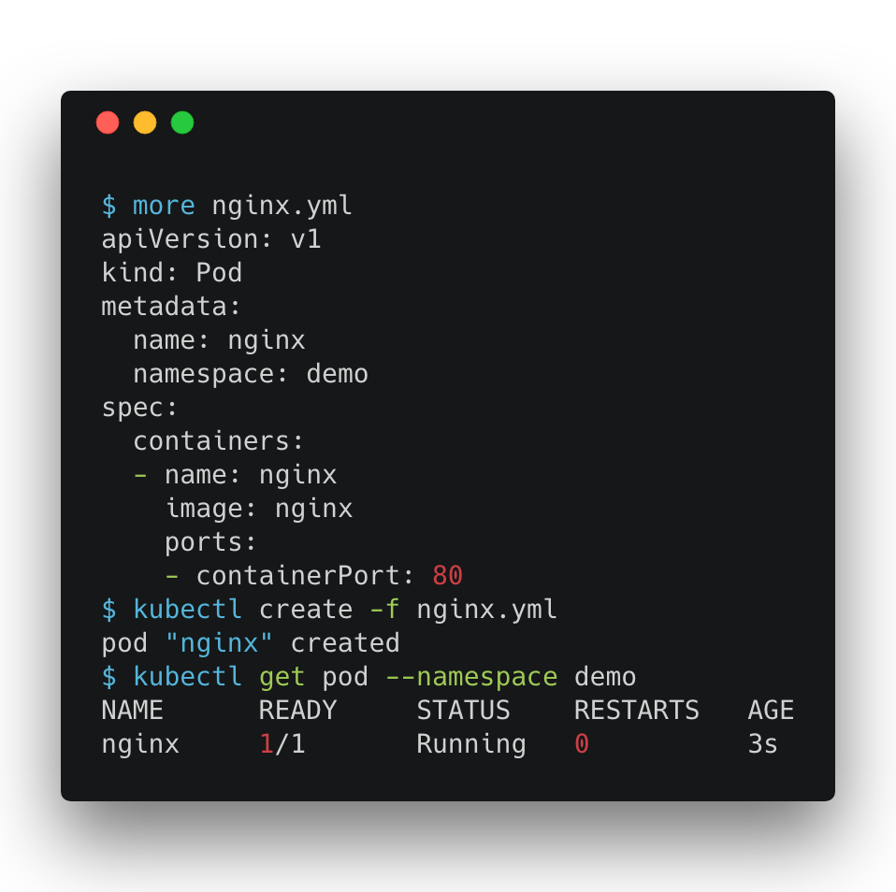
Create Pod with namespace

Slide 33
Deployment

Slide 34
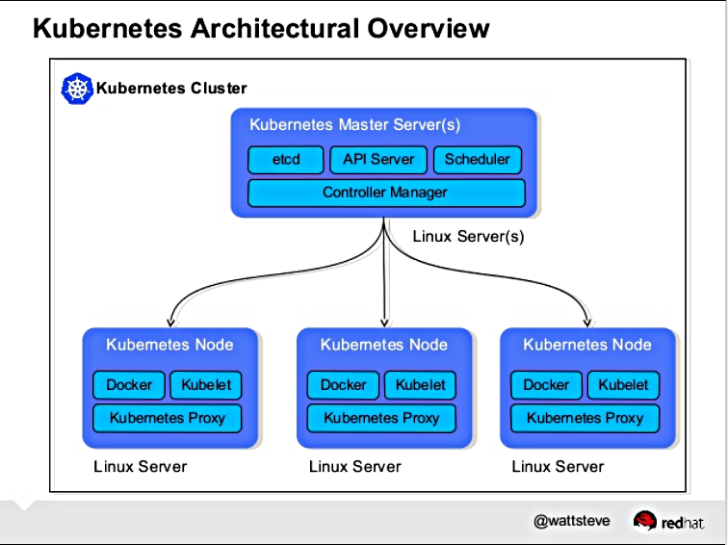
Controller

Slide 35
Writing Controllers
for { desired := getDesiredState() current := getCurrentState() makeChanges(desired, current) }

Slide 36
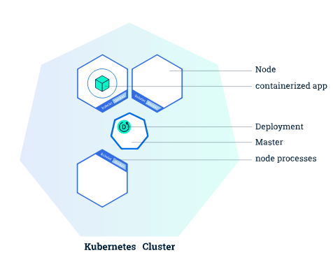
Deployment
With Kubernetes Deployments, you “describe a desired state in a Deployment object, and the Deployment controller changes the actual state to the desired state at a controlled rate,” the Kubernetes Deployment documentation states.

Slide 37
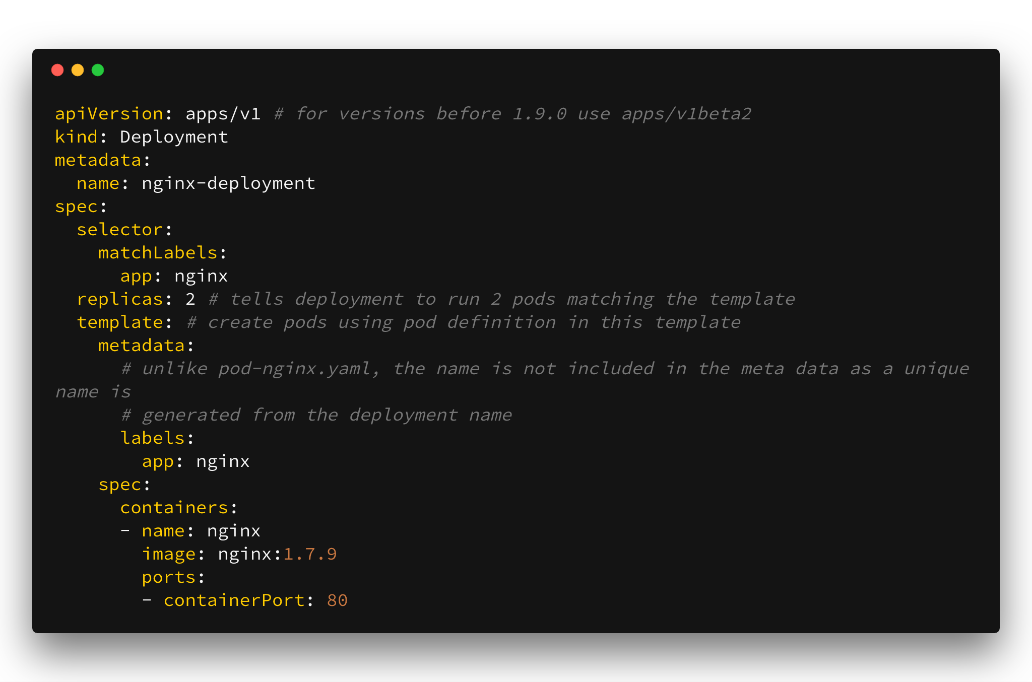
demo

Slide 38
Cluster Basic Network

Slide 39
Pod - Pod Networking
all containers can communicate with all other containers without NAT
all nodes can communicate with all containers (and vice-versa) without NAT
the IP that a container sees itself as is the same IP that others see it as
pod-nginx
weave
weave
pod-busybox
eth1
eth1
k8s-node1
k8s-node2
https://kubernetes.io/docs/concepts/cluster-administration/networking/

Slide 40
Service

Slide 41
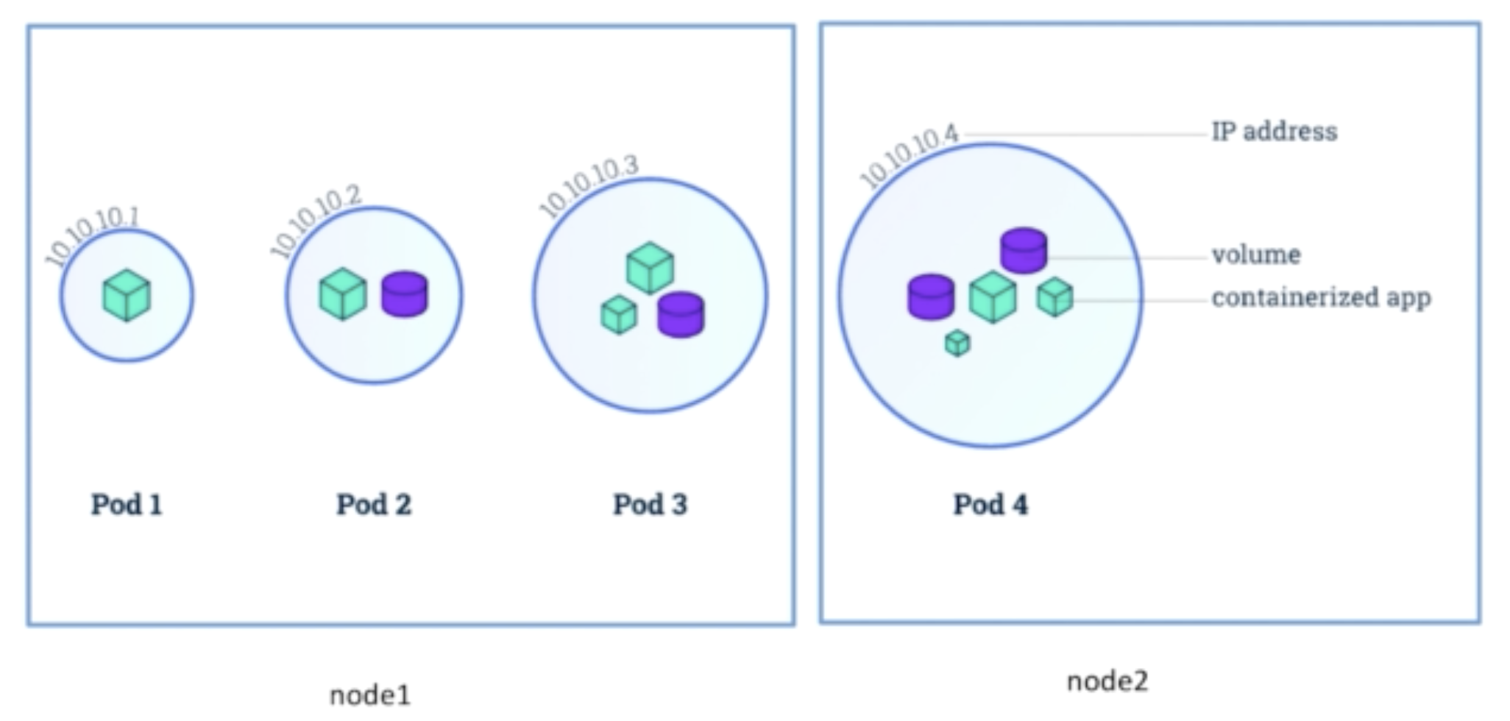
Pod Network

Slide 42
Why don’t use Pod IP directly
When the Pod die, the Pod IP will gone
When use deployment or ReplicaSet, pod will be recreated when update image, and will be terminated when scale down
Multiple IP address when using replica in ReplicaSet

Slide 43
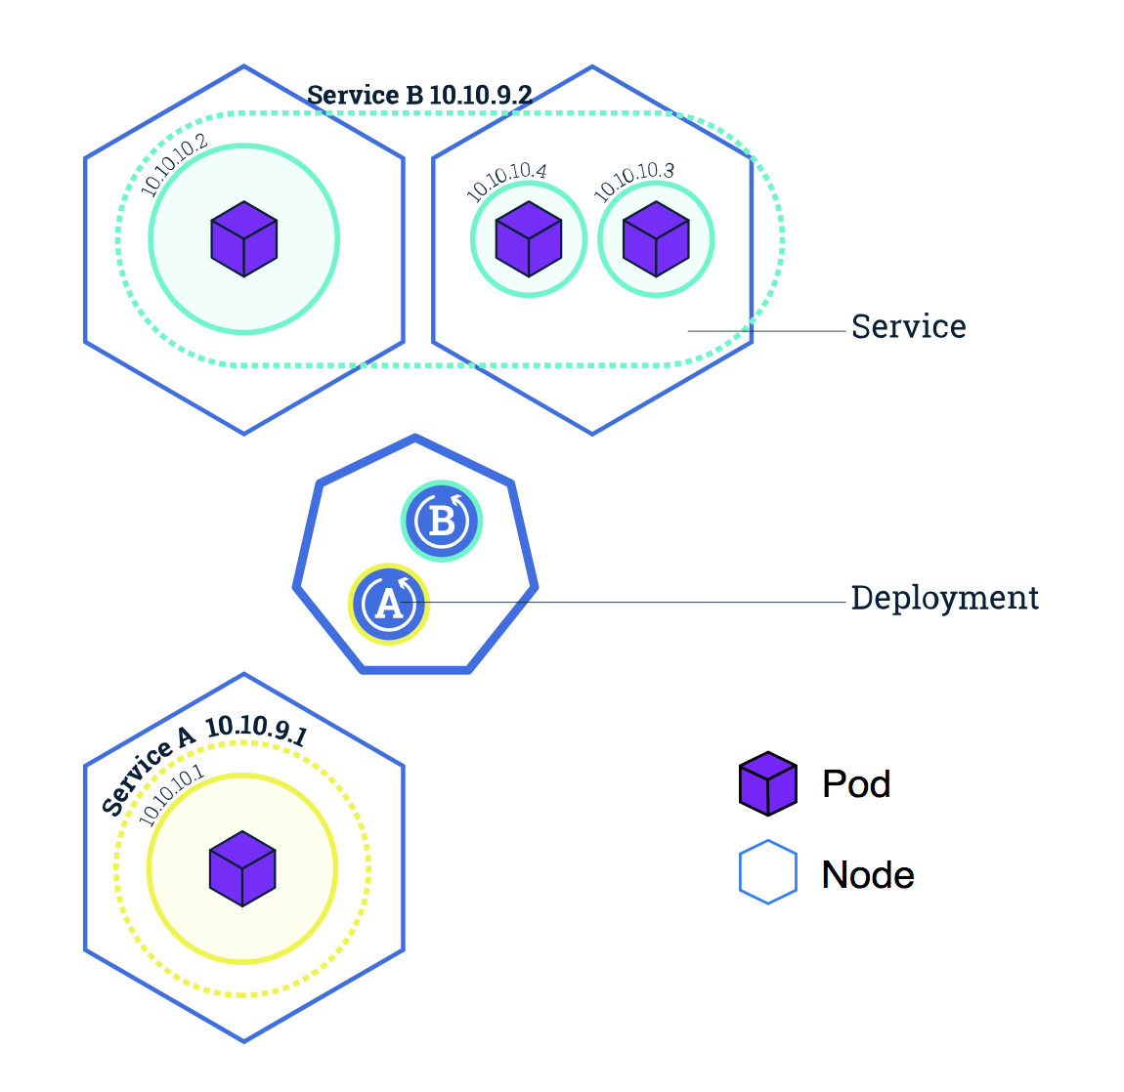
Pod, Service and Label

Slide 44
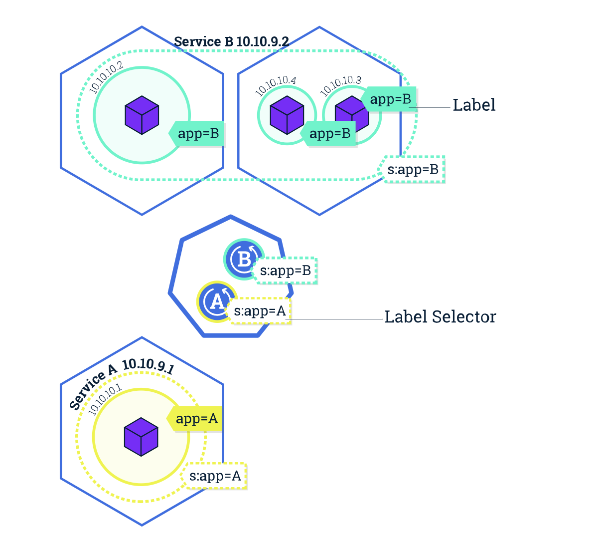
Pod, Service and Label

Slide 45
Service Types
ClusterIP
NodePort
LoadBalancer

Slide 46
ClusterIP
Create service for pod
How does ClusterIP service for pod work?
Create service for deployment
How does ClusterIP service for deployment work?

Slide 47
ClusterIP
How to create ClusterIP Service?
Why we need ClusterIP Service?
How does ClusterIP work?

Slide 48
Create ClusterIP Service
kubectl expose <resource> <resource name>
# Create a service for an nginx deployment, which serves on port 80 and connects to the containers on port 8000. kubectl expose deployment nginx --port=80 --target-port=8000
# Create a service for a pod valid-pod, which serves on port 444 with the name "frontend" kubectl expose pod valid-pod --port=444 --name=frontend
kubectl create xxx.yml

Slide 49
Service Creation
kubectl expose <resource> <resource name>
kubectl create xxx.yml

Slide 50
How does that work?
apiserver: kubectl -> apiserver -> etcd
kube-proxy: get the changes about service/pod, and do some change in local iptables (every k8s node)
iptables: virtual IP tech for data forwarding and load balancing.
k8s-master
k8s-node1
k8s-node2
pod
iptables
iptables
kubectl
api-server
etcd
kubelet
kube-proxy
kubelet
kube-proxy

Slide 51
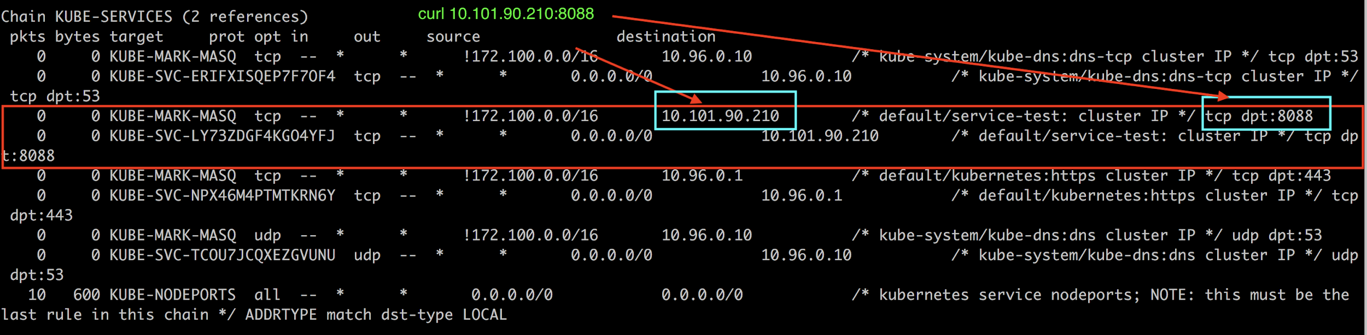
How does that work?

Slide 52
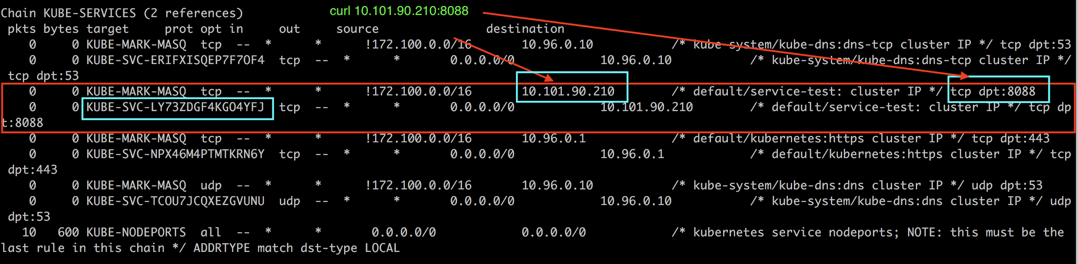
How does that work?

Slide 53
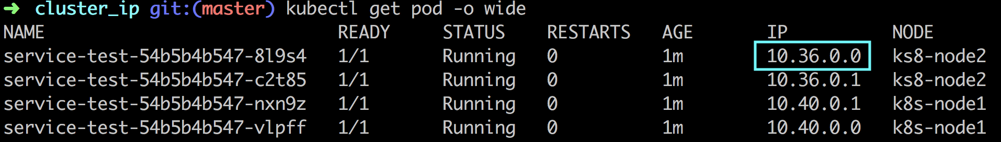
How does that work?

Slide 54
Health Check

Slide 55


Why we need Health Check?
Is your application health?
Instance 1
Instance 2
request

Slide 56
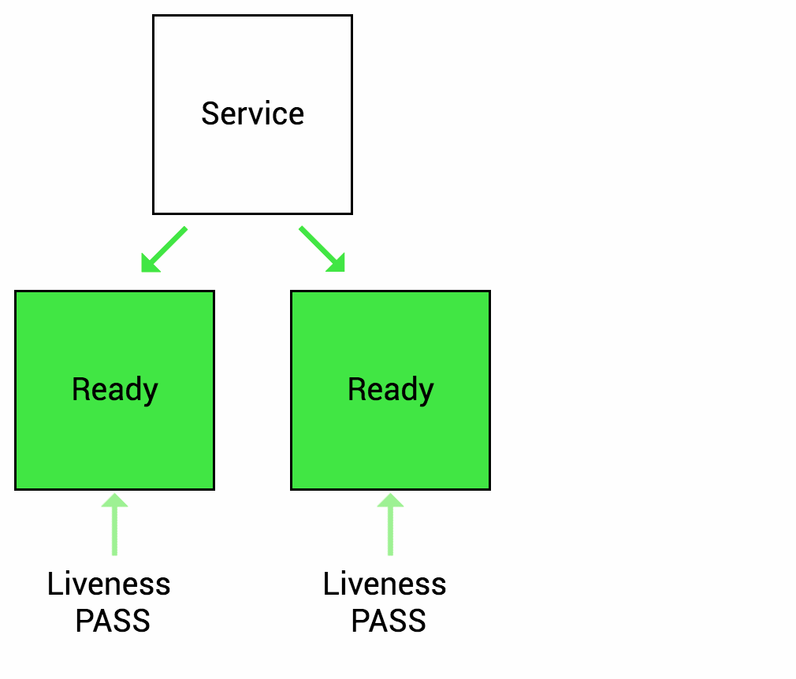
Liveness Probe
Many applications running(pod is running) for long periods of time eventually transition to broken states(but application was down), and cannot recover except by being restarted.
Kubernetes provides liveness probes to detect and remedy such situations.

Slide 57
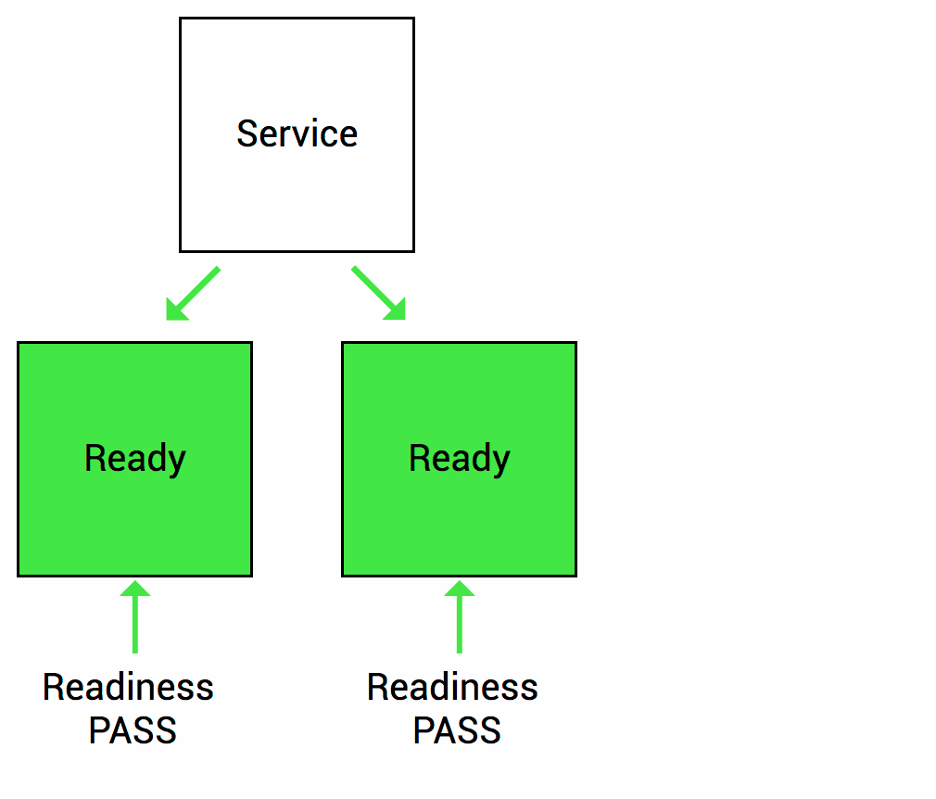
Readiness Probe
Sometimes, applications are temporarily unable to serve traffic. For example, an database application might need to do some initial configuration during startup. In such cases:
you don’t want to kill the application (if you defined a liveness probe, and the service is temporarily unlive)
you don’t want to send it requests either.
Kubernetes provides readiness probes to detect and mitigate these situations. A pod with containers reporting that they are not ready does not receive traffic through Kubernetes Services.
Readiness probes are configured similarly to liveness probes. The only difference is that you use the readinessProbe field instead of the livenessProbe field

Slide 58
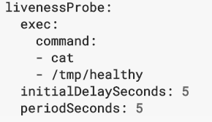
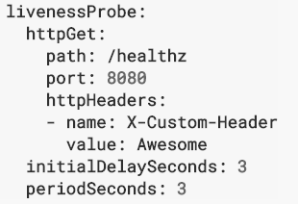
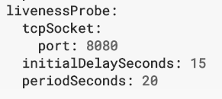
Probe Type
HTTP
Command
TCP

Slide 59
Health Check Reference
https://kubernetes.io/docs/reference/generated/kubernetes-api/v1.11/#probe-v1-core probe type
https://kubernetes.io/docs/tasks/configure-pod-container/configure-liveness-readiness-probes/#define-readiness-probes documentation and examples

Slide 60
Service Discovery

Slide 61
Pod 1
Pod 2
IP: 1.1.1.1
IP: 2.2.2.2
Service: app1
Service: app2
Ip: 10.140.0.1
Ip: 10.140.0.2
Container1
Container2
How to communicate?

Slide 62
Service Discovery
DNS
Environment Variable

Slide 63
Env var - Service Discovery
REDIS_MASTER_SERVICE_HOST=10.0.0.11 REDIS_MASTER_SERVICE_PORT=6379 REDIS_MASTER_PORT=tcp://10.0.0.11:6379 REDIS_MASTER_PORT_6379_TCP=tcp://10.0.0.11:6379 REDIS_MASTER_PORT_6379_TCP_PROTO=tcp REDIS_MASTER_PORT_6379_TCP_PORT=6379 REDIS_MASTER_PORT_6379_TCP_ADDR=10.0.0.11

Slide 64
DNS - Service Discovery (prefer)
Every Service in Kubernetes Cluster gets a DNS name
Format:
<server-name>.<namespace>.svc.cluster.local

Slide 65
Service Types
ClusterIP: Exposes the service on a cluster-internal IP. Choosing this value makes the service only reachable from within the cluster. This is the default ServiceType.
NodePort: Exposes the service on each Node’s IP at a static port (the NodePort). A ClusterIP service, to which the NodePort service will route, is automatically created. You’ll be able to contact the NodePort service, from outside the cluster, by requesting <NodeIP>:<NodePort>.
LoadBalancer: Exposes the service externally using a cloud provider’s load balancer.NodePort and ClusterIP services, to which the external load balancer will route, are automatically created.
ExternalName: Maps the service to the contents of the externalName field (e.g. foo.bar.example.com), by returning a CNAME record with its value. No proxying of any kind is set up. This requires version 1.7 or higher of kube-dns.

Slide 66
Service Discovery
Both DNS entry and Env variables can only be used within k8s cluster for communications between different parts of applications.
What about inbound traffic? (NodePort, External LB?)
We need ingress
Allow connections from outside of the cluster to visit Services within the cluster.
It’s an alternative for external LoadBalancer and NodePort Service
Expose services that need to be accessible from outside of the cluster

Slide 67
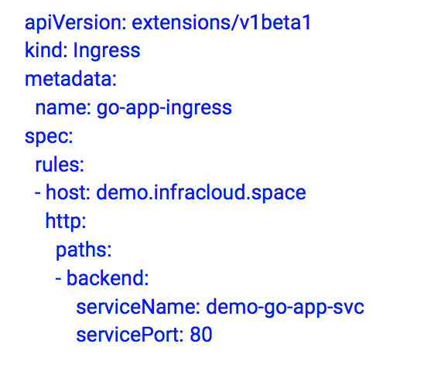
Ingress Controller and Resource Definition
Ingress Resource defines routing conditions to a service

Slide 68
Ingress Controller and Resource Definition
Ingress controller is a controller which watches for Ingress resources and updates its rules to satisfy routing conditions mentioned in Ingress resource
Common Ingress Controllers:
Nginx
Traefik
HAproxy
Envoy

Slide 69
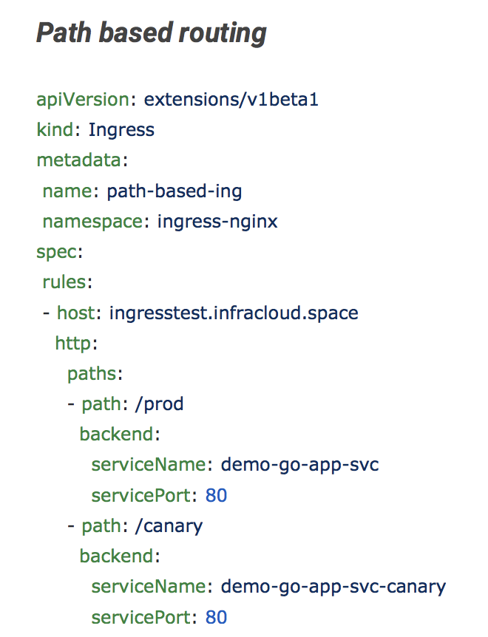
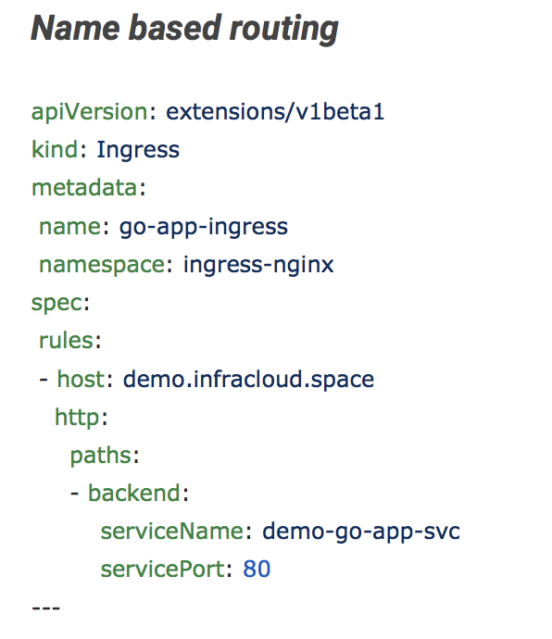
Routing in ingress

Slide 70
Web UI

Slide 71
Overview
https://kubernetes-master/ui
Deploy manually
$ kubectl apply -f https://raw.githubusercontent.com/kubernetes/dashboard/master/src/deploy/recommended/kubernetes-dashboard.yaml
$ kubectl config view
For minikube
$ minikube dashboard
$ minikube dashboard --url

Slide 72
Kubernetes Storage Abstractions

Slide 73
Overview
Volumes
Volumes are storage accessible to containers in a Pod. Some Volume types are backed by ephemeral storage and are useful for storing configuration information and as scratch space for applications. Other Volume types are backed by durable storage.
PersistentVolumes
Persistent Volumes are cluster resources that Pods can use for durable storage. PersistentVolumesClaims can be used to dynamically provision Persistent Volumes backed by Compute Engine persistent disks for use in your cluster. You can also use PersistentVolumeClaims to provision other types of backing storage like NFS.

Slide 74
persistentVolume(PV)
A PersistentVolume (PV) is a piece of storage in the cluster that has been provisioned by an administrator. It is a resource in the cluster just like a node is a cluster resource. PVs are volume plugins like Volumes, but have a lifecycle independent of any individual pod that uses the PV. This API object captures the details of the implementation of the storage, be that NFS, iSCSI, or a cloud-provider-specific storage system.

Slide 75
persistentVolumeClaim(PVC)
A PersistentVolumeClaim (PVC) is a request for storage by a user. It is similar to a pod. Pods consume node resources and PVCs consume PV resources. Pods can request specific levels of resources (CPU and Memory). Claims can request specific size and access modes (e.g., can be mounted once read/write or many times read-only).

Slide 76
persistentVolumeClaim(PVC)
A persistentVolumeClaim volume is used to mount a PersistentVolume into a Pod. PersistentVolumes are a way for users to “claim” durable storage (such as a GCE PersistentDisk or an iSCSI volume) without knowing the details of the particular cloud environment

Slide 77
Secret

Slide 78
Overview
Secrets are namespaced objects, that is, exist in the context of a namespace
You can access them via a volume or an environment variable from a container running in a pod
The secret data on nodes is stored in tmpfs volumes
A per-secret size limit of 1MB exists
The API server stores secrets as plaintext in etcd

Slide 79
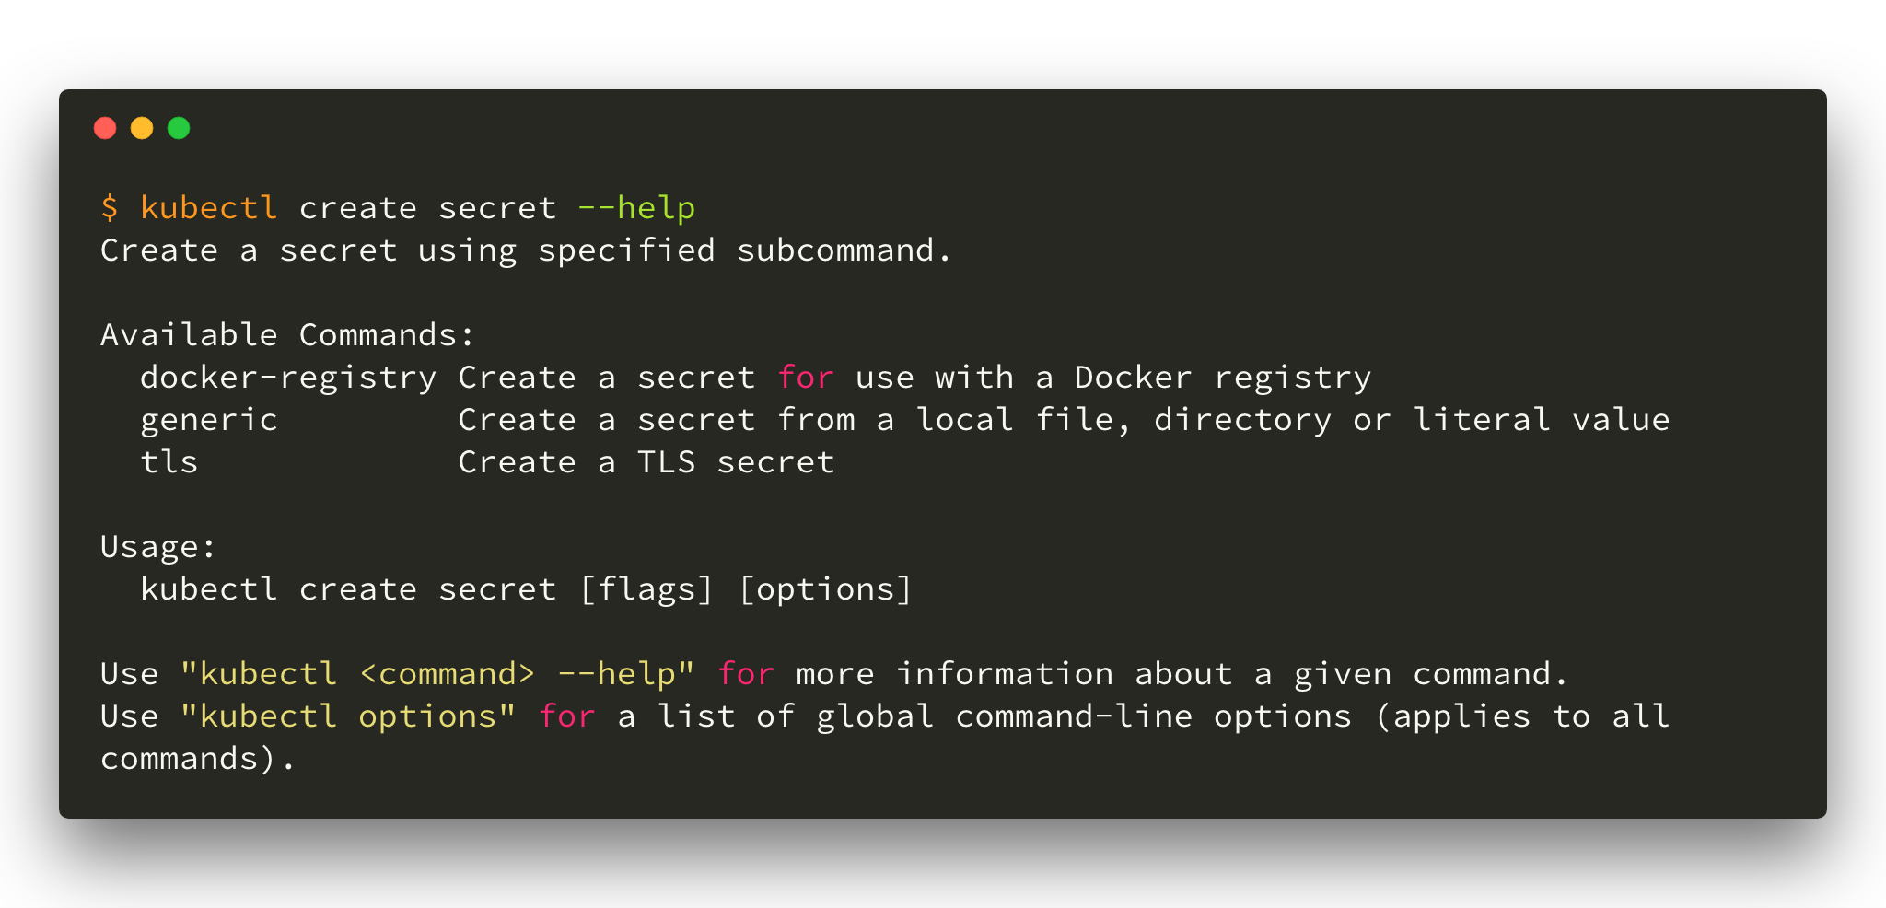
Create Secret

Slide 80
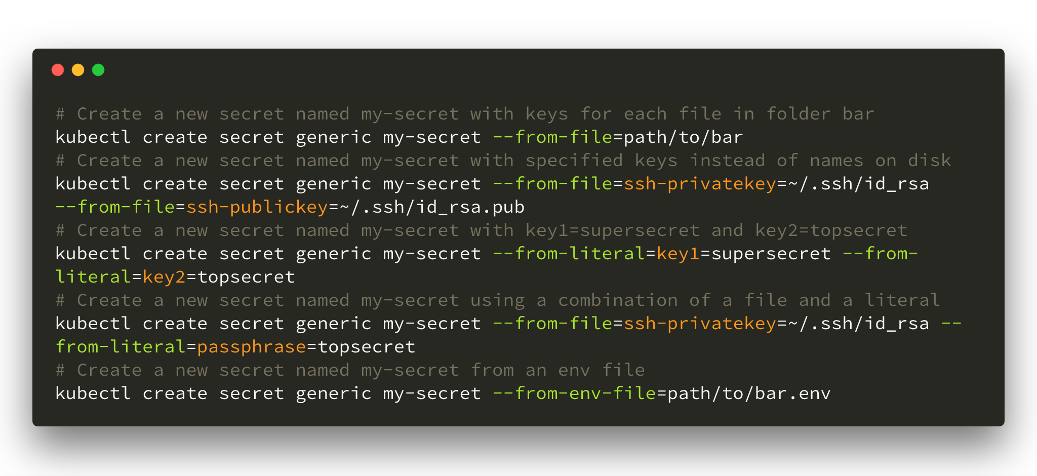
Create secret

Slide 81
configMap

Slide 82
Overview
Configuration parameters can be put in configMap
The configMap key-value pairs can be read by app:
Environment variables
Volumes

Slide 83
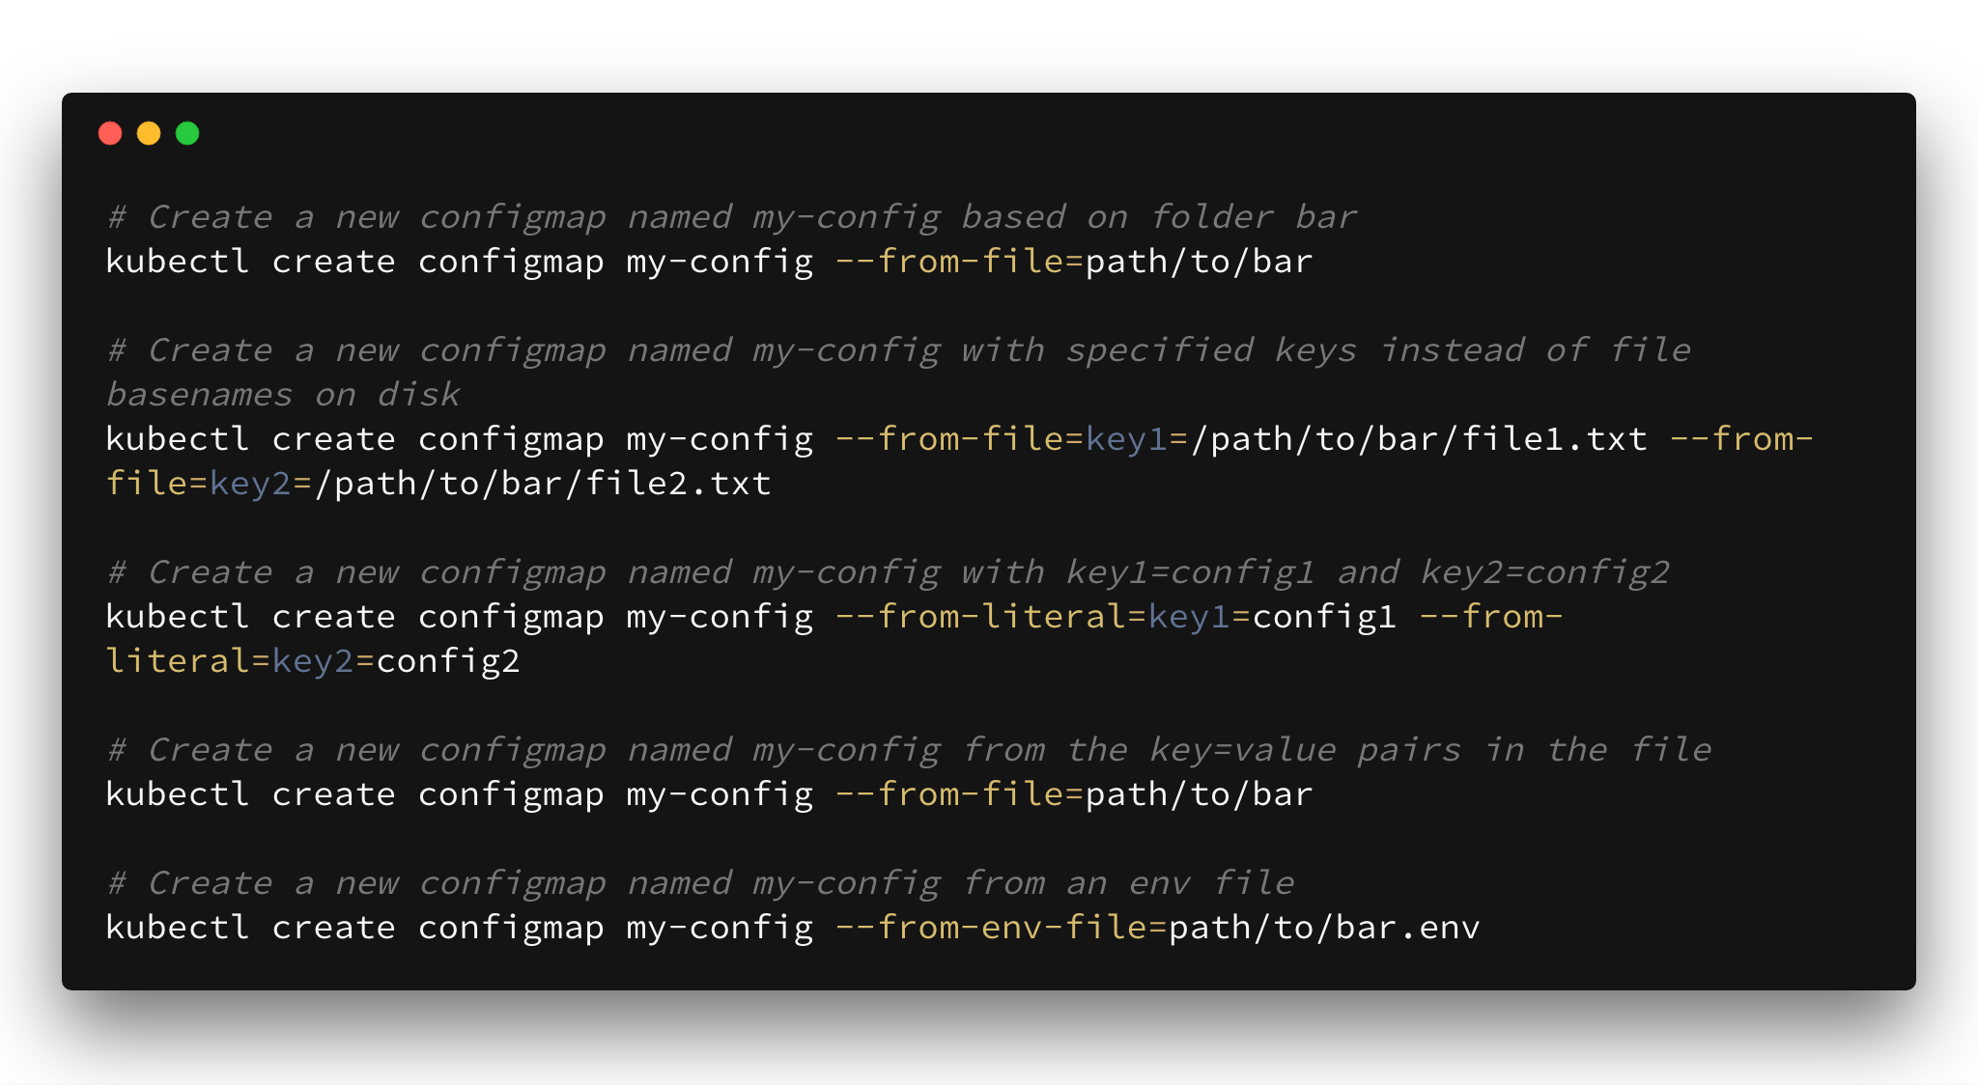
Create

